Slide 1
Classification Chart
Animal | skin/hair | fur | Hoof | claws | lungs | Jaws | wings
Panthera Leo (lion)
Sus scrofa (pig)
Equus caballus (horse)
Camelus dromedaries (Arabian camel)
Equus zebra (mountain zebra)
Loxodonta Africana (African elephant)
Talpa europaea(European mole)
Myotis velifer (cave bat)

Slide 2
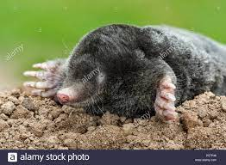
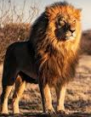
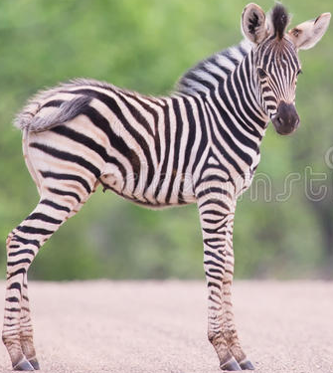
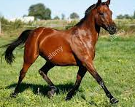
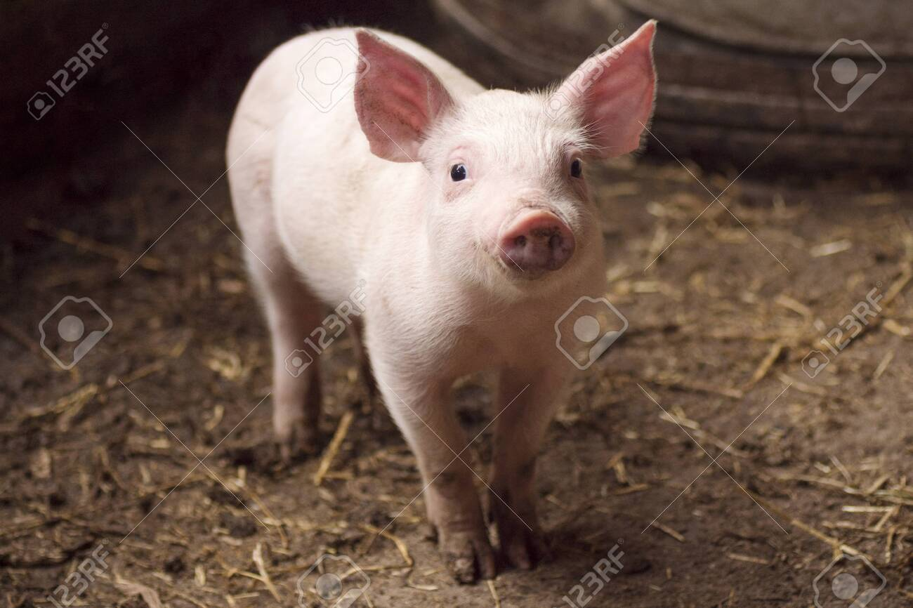
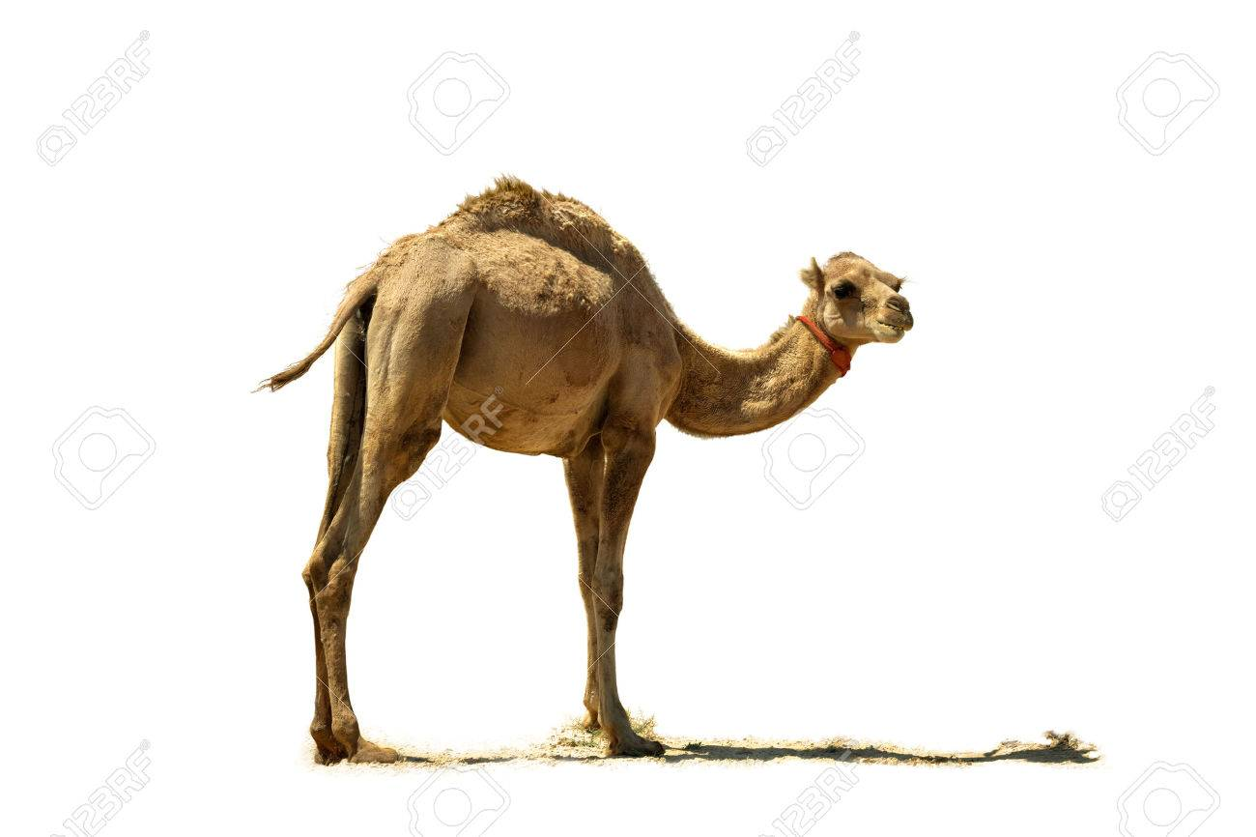
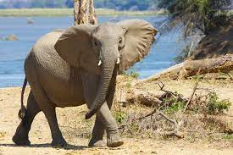
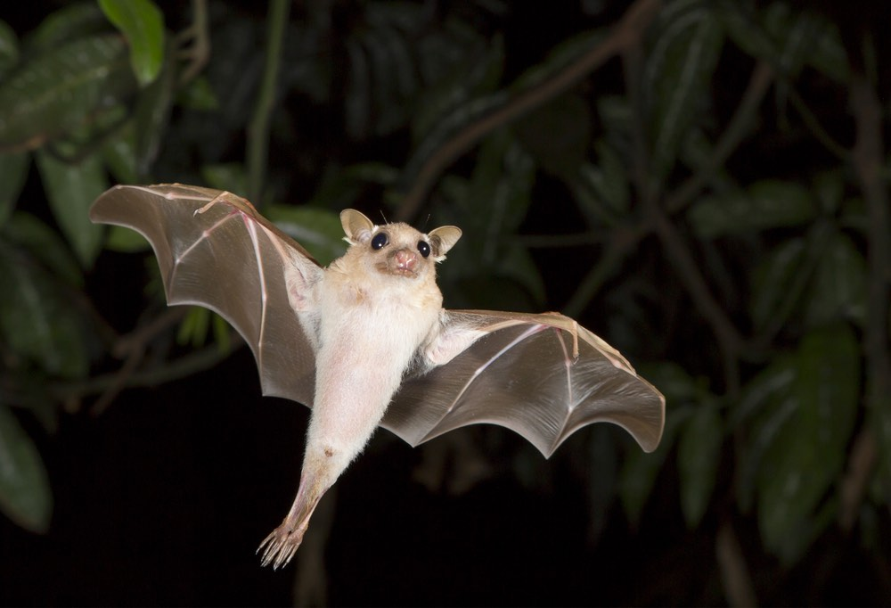
Have claws
Have hoof
Have fur
Have wings
Have skin/hair and hooves
Have lungs and jaws

